Slide 1
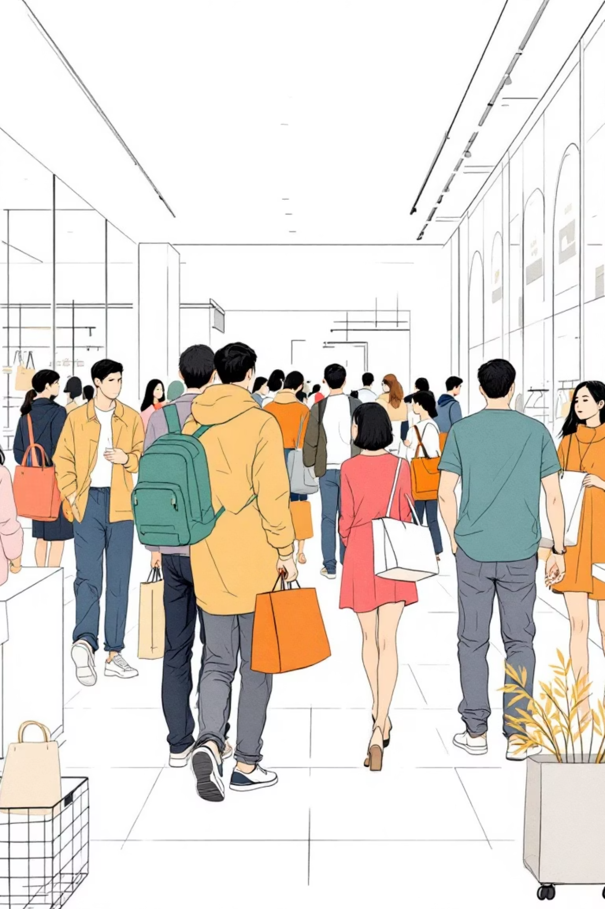
Customer Shopping Behavior Analysis
Uncovering insights from transactional data to guide strategic business decisions.

Slide 2

Project Overview
Goal
Data Source
Analyze 3,900 purchases to understand spending patterns, customer segments, product preferences, and subscription behavior.
Transactional data across various product categories.
Outcome
Provide actionable insights for strategic business decisions.

Slide 3
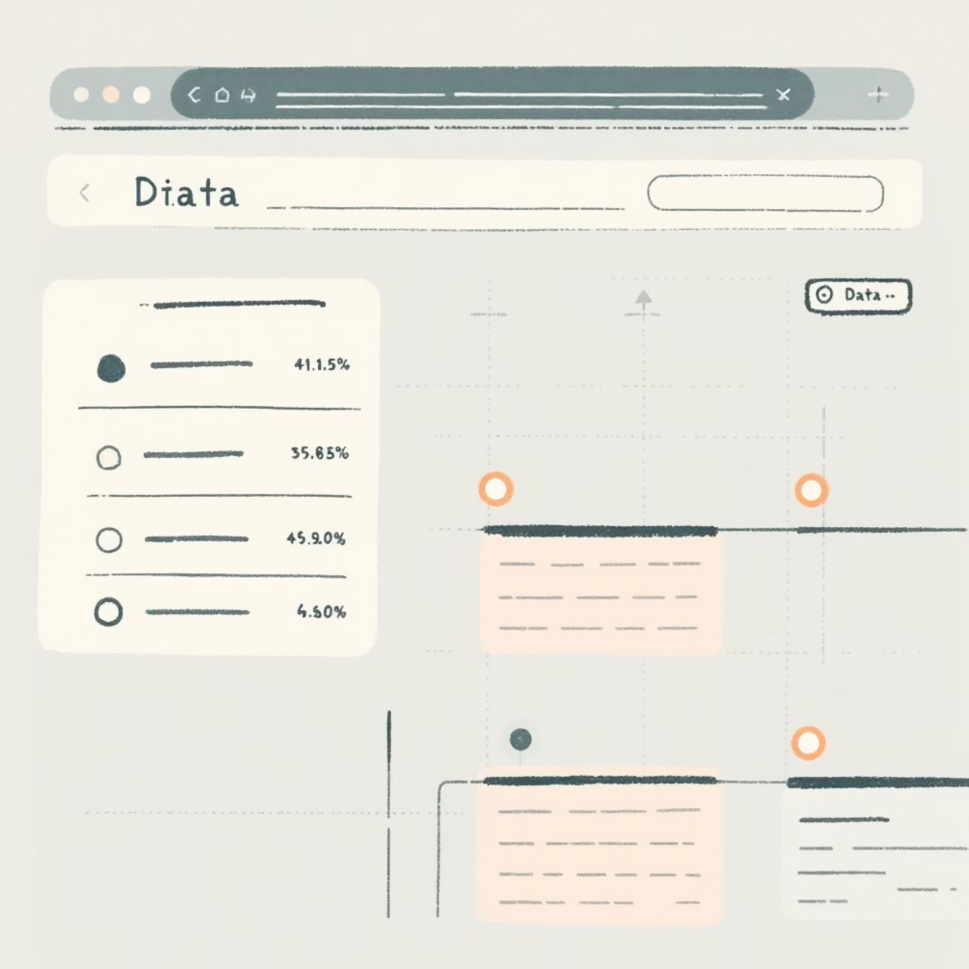
Dataset Summary
Key Features
Data Snapshot
Customer demographics (Age, Gender, Location, Subscription Status)
3,900 Rows
Purchase details (Item, Category, Amount, Season, Size, Color)
18 Columns
Shopping behavior (Discount, Promo Code, Previous Purchases, Frequency, Review Rating, Shipping Type)
37 missing values in "Review Rating"

Slide 4
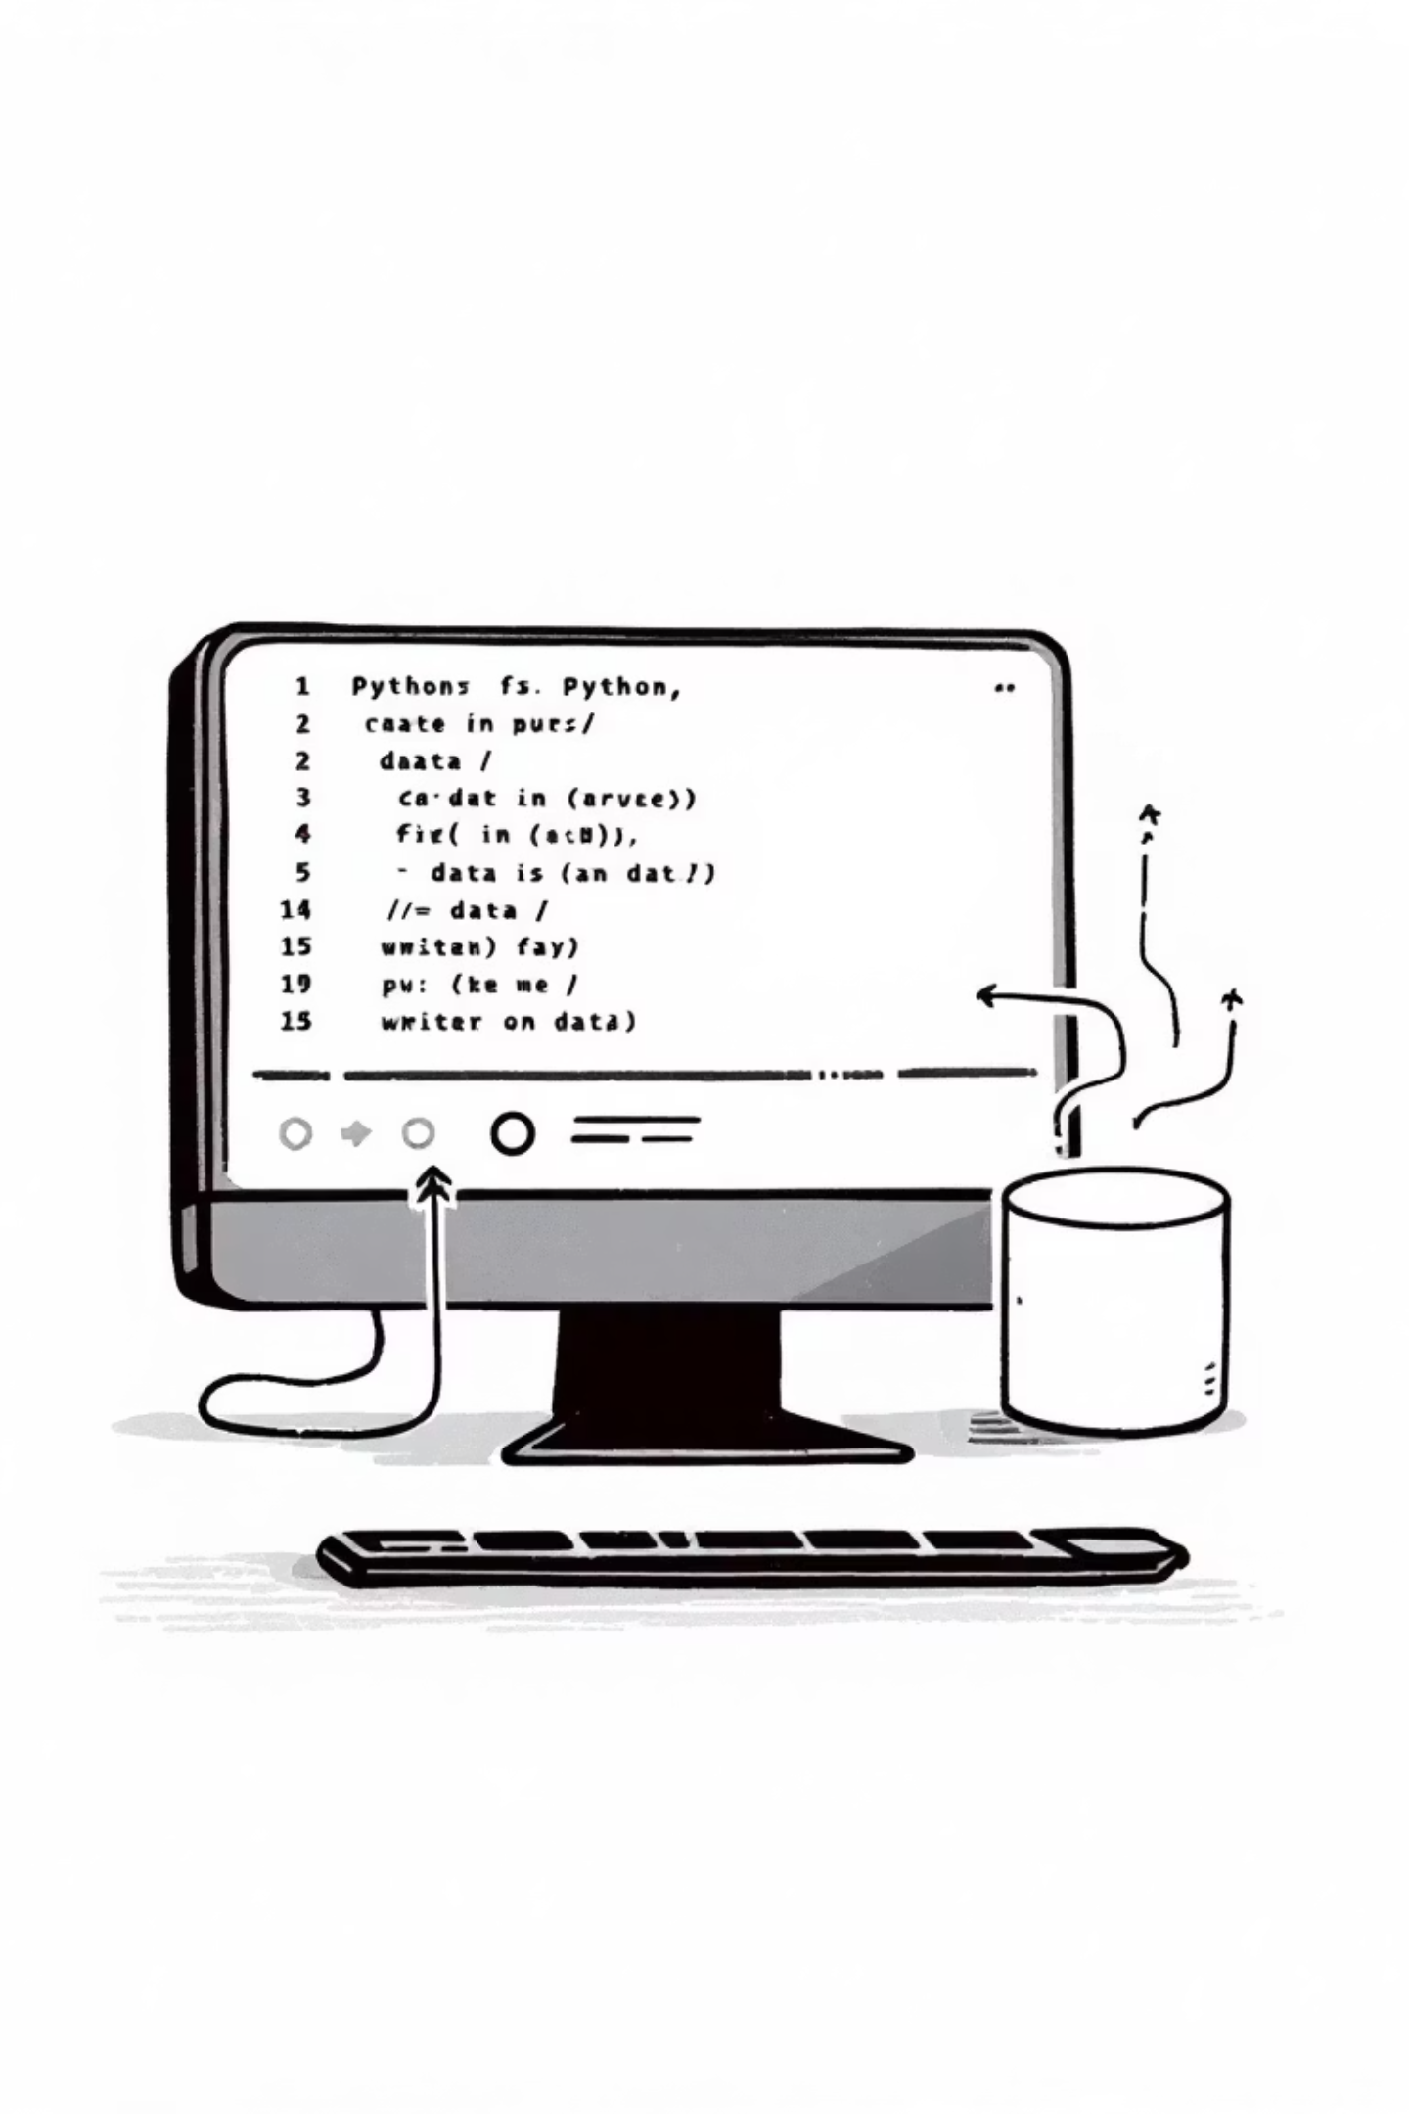
Exploratory Data Analysis (Python)
01
Data Preparation
Loading, initial exploration, and handling missing values (imputed median rating).
02
Column Standardization
Renamed columns to snake_case for readability.
03
Feature Engineering
Created 'age_group' and 'purchase_frequency_days'.
04
Database Integration
Loaded cleaned data into PostgreSQL for SQL analysis.

Slide 5

Data Analysis using SQL
1
Revenue by Gender
Female: $75,191, Male: $157,890
2
High-Spending Discount Users
Identified customers using discounts but spending above average.
3
Top 5 Products by Rating
Gloves (3.86), Sandals (3.84), Boots (3.82), Hat (3.80), Skirt (3.78)
4
Shipping Type Comparison
Standard: $58.46, Express: $60.48

Slide 6
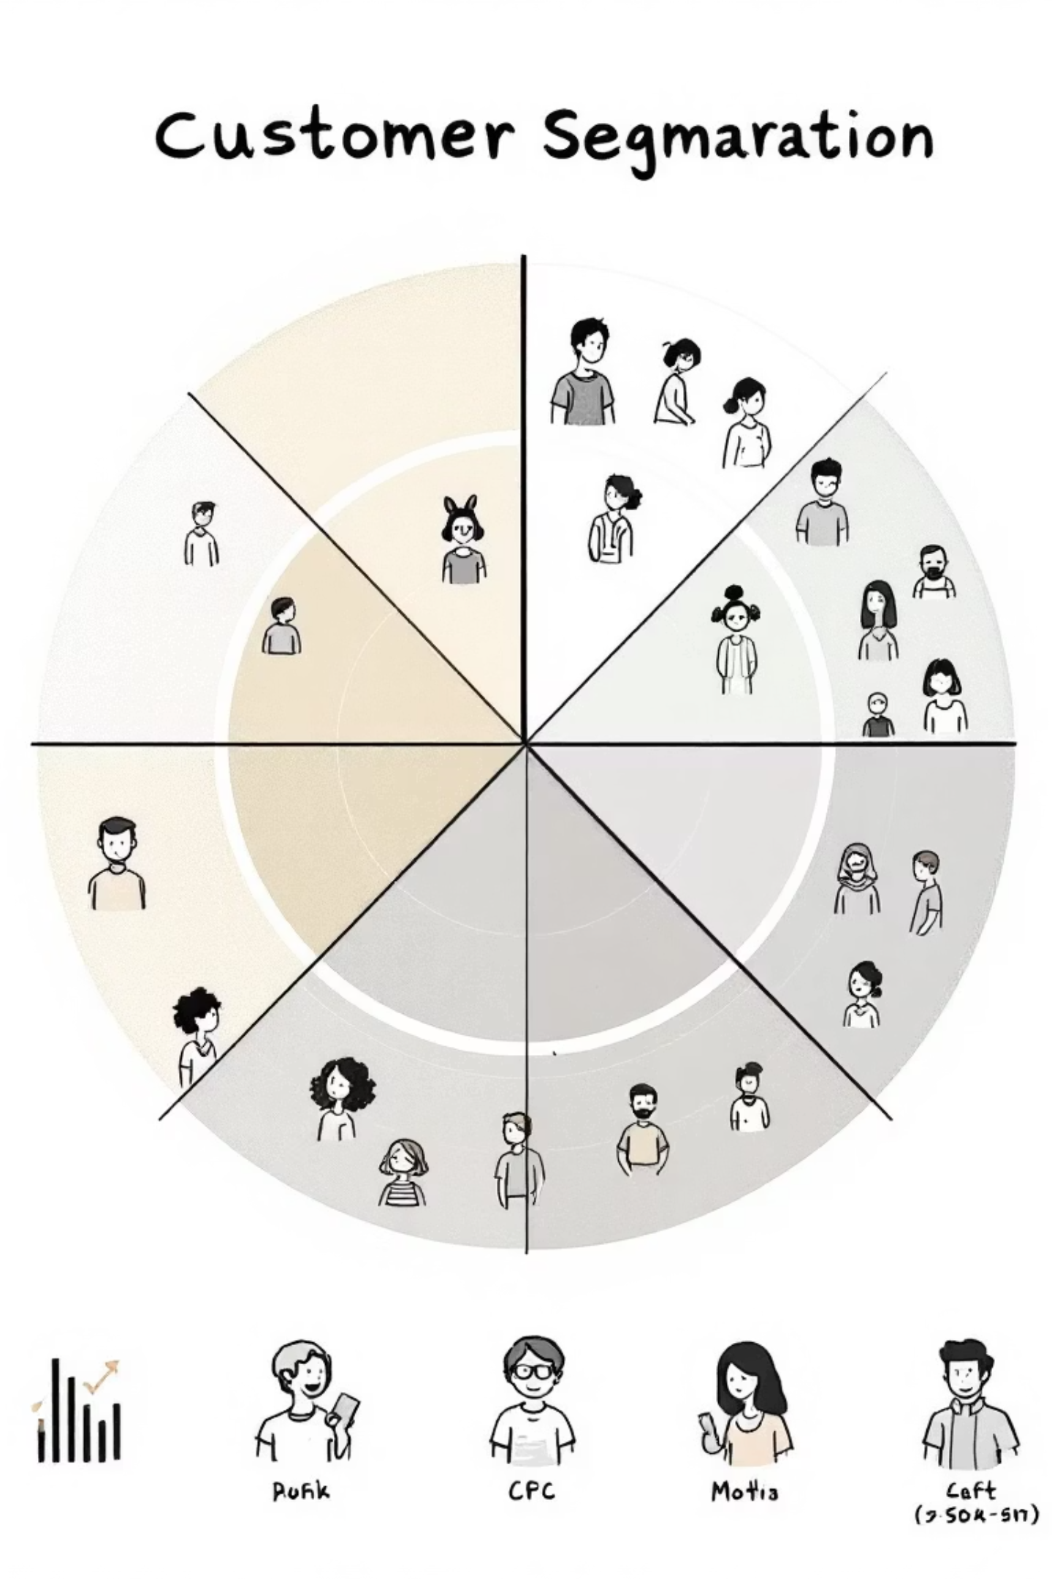
SQL Insights: Customer Behavior
1
2
Subscribers vs. Non-Subscribers
Discount-Dependent Products
Subscribers: 1,053 customers, Avg Spend: $59.49, Total Revenue: $62,645
Hat (50%), Sneakers (49.66%), Coat (49.07%), Sweater (48.17%), Pants (47.37%)
Non-Subscribers: 2,847 customers, Avg Spend: $59.87, Total Revenue: $170,436
3
Customer Segmentation
Loyal (3,116), Returning (701), New (83)

Slide 7
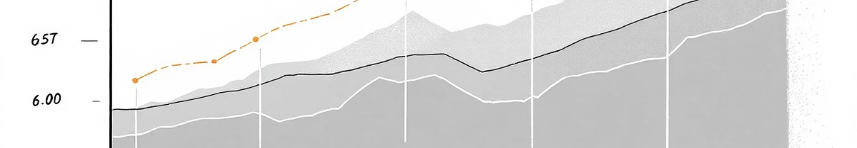
SQL Insights: Product & Age
1
2
3
Top 3 Products per Category
Repeat Buyers & Subscriptions
Revenue by Age Group
Accessories: Jewelry, Sunglasses, Belt
Young Adult: $62,143
Clothing: Blouse, Pants, Shirt
Repeat buyers (>5 purchases): 958 subscribers vs. 2,518 non-subscribers.
Middle-aged: $59,197
Footwear: Sandals, Shoes, Sneakers
Adult: $55,978
Outerwear: Jacket, Coat
Senior: $55,763

Slide 8

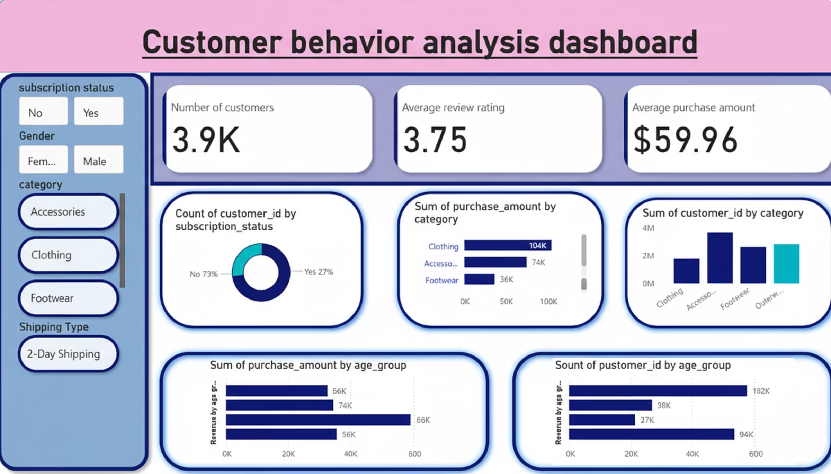
Power BI Dashboard
An interactive dashboard was built to present these insights visually.

Slide 9


Business Recommendations
Boost Subscriptions
Promote exclusive benefits to increase subscriber base.
Customer Loyalty Programs
Reward repeat buyers to foster loyalty and move them to the "Loyal" segment.
Review Discount Policy
Optimize discount strategies to balance sales with profit margins.

Slide 10

Strategic Actions
Product Positioning
Highlight top-rated and best-selling products in marketing campaigns.
Targeted Marketing
Focus efforts on high-revenue age groups and express-shipping users for maximum impact.

